Slide 1
Operating System
Dr. Kaushal Shah
Assistant Professor
Computer Engineering
PDEU
The compilation of the PPTs is from the source:
All the different articles and research papers available on internet and NPTEL

Slide 2
Outline for Today
Process Scheduling
IPC

Slide 3
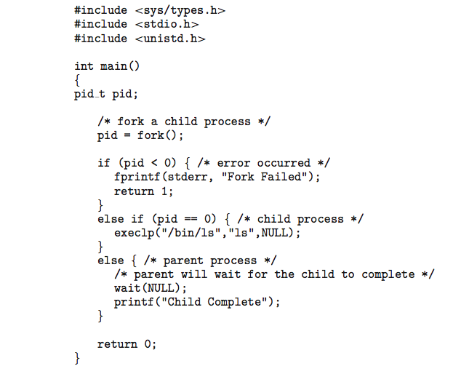
C Program Forking Separate Process

Slide 4
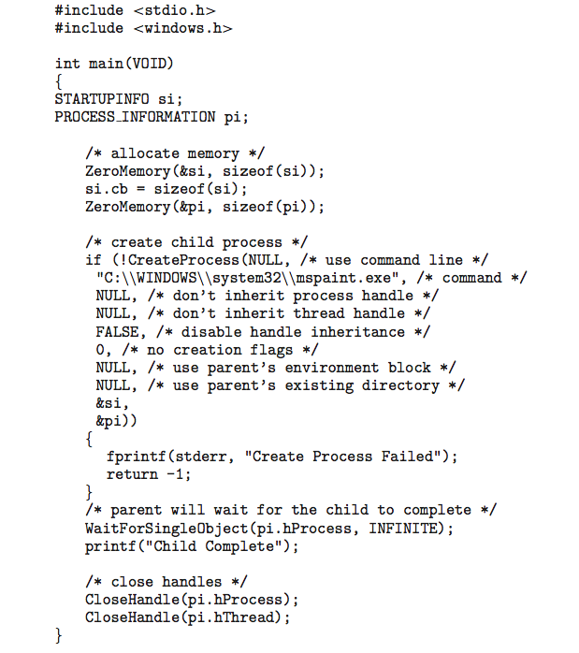
Creating a Separate Process via Windows API

Slide 5
Process Termination
Process executes last statement and then asks the operating system to delete it using the exit() system call.
Returns status data from child to parent (via wait())
Process’ resources are deallocated by operating system
Parent may terminate the execution of children processes using the abort() system call. Some reasons for doing so:
Child has exceeded allocated resources
Task assigned to child is no longer required
The parent is exiting and the operating systems does not allow a child to continue if its parent terminates

Slide 6
Process Termination
Some operating systems do not allow child to exists if its parent has terminated. If a process terminates, then all its children must also be terminated.
cascading termination. All children, grandchildren, etc. are terminated.
The termination is initiated by the operating system.
The parent process may wait for termination of a child process by using the wait()system call. The call returns status information and the pid of the terminated process
pid = wait(&status);
If no parent waiting (did not invoke wait()) process is a zombie
If parent terminated without invoking wait , process is an orphan

Slide 7

Multiprocess Architecture – Chrome Browser
Many web browsers ran as single process (some still do)
If one web site causes trouble, entire browser can hang or crash
Google Chrome Browser is multiprocess with 3 different types of processes:
Browser process manages user interface, disk and network I/O
Renderer process renders web pages, deals with HTML, Javascript. A new renderer created for each website opened
Runs in sandbox restricting disk and network I/O, minimizing effect of security exploits
Plug-in process for each type of plug-in

Slide 8
Interprocess Communication
Processes within a system may be independent or cooperating
Cooperating process can affect or be affected by other processes, including sharing data
Reasons for cooperating processes:
Information sharing
Computation speedup
Modularity
Convenience
Cooperating processes need interprocess communication (IPC)
Two models of IPC
Shared memory
Message passing

Slide 9
Communications Models
(a) Message passing. (b) shared memory.

Slide 10
Cooperating Processes
Independent process cannot affect or be affected by the execution of another process
Cooperating process can affect or be affected by the execution of another process
Advantages of process cooperation
Information sharing
Computation speed-up
Modularity
Convenience

Slide 11
Producer-Consumer Problem
Paradigm for cooperating processes, producer process produces information that is consumed by a consumer process
unbounded-buffer places no practical limit on the size of the buffer
bounded-buffer assumes that there is a fixed buffer size

Slide 12
Bounded-Buffer – Shared-Memory Solution
Shared data
#define BUFFER_SIZE 10
typedef struct {
. . .
} item;
item buffer[BUFFER_SIZE];
int in = 0;
int out = 0;
Solution is correct, but can only use BUFFER_SIZE-1 elements

Slide 13
Bounded-Buffer – Producer
item next_produced;
while (true) {
/* produce an item in next produced */
while (((in + 1) % BUFFER_SIZE) == out)
; /* do nothing */
buffer[in] = next_produced;
in = (in + 1) % BUFFER_SIZE;
}

Slide 14
Bounded Buffer – Consumer
item next_consumed;
while (true) { while (in == out)
; /* do nothing */ next_consumed = buffer[out];
out = (out + 1) % BUFFER_SIZE;
/* consume the item in next consumed */
}

Slide 15
Interprocess Communication – Shared Memory
An area of memory shared among the processes that wish to communicate
The communication is under the control of the users processes not the operating system.
Major issues is to provide mechanism that will allow the user processes to synchronize their actions when they access shared memory.

Slide 16
Interprocess Communication – Message Passing
Mechanism for processes to communicate and to synchronize their actions
Message system – processes communicate with each other without resorting to shared variables
IPC facility provides two operations:
send(message)
receive(message)
The message size is either fixed or variable

Slide 17
Message Passing (Cont.)
If processes P and Q wish to communicate, they need to:
Establish a communication link between them
Exchange messages via send/receive
Implementation issues:
How are links established?
Can a link be associated with more than two processes?
How many links can there be between every pair of communicating processes?
What is the capacity of a link?
Is the size of a message that the link can accommodate fixed or variable?
Is a link unidirectional or bi-directional?

Slide 18
Message Passing (Cont.)
Implementation of communication link
Physical:
Shared memory
Hardware bus
Network
Logical:
Direct or indirect
Synchronous or asynchronous
Automatic or explicit buffering

Slide 19
Direct Communication
Processes must name each other explicitly:
send (P, message) – send a message to process P
receive(Q, message) – receive a message from process Q
Properties of communication link
Links are established automatically
A link is associated with exactly one pair of communicating processes
Between each pair there exists exactly one link
The link may be unidirectional, but is usually bi-directional

Slide 20
Indirect Communication
Messages are directed and received from mailboxes (also referred to as ports)
Each mailbox has a unique id
Processes can communicate only if they share a mailbox
Properties of communication link
Link established only if processes share a common mailbox
A link may be associated with many processes
Each pair of processes may share several communication links
Link may be unidirectional or bi-directional

Slide 21
Indirect Communication
Operations
create a new mailbox (port)
send and receive messages through mailbox
destroy a mailbox
Primitives are defined as:
send(A, message) – send a message to mailbox A
receive(A, message) – receive a message from mailbox A

Slide 22
Indirect Communication
Mailbox sharing
P₁, P₂, and P₃ share mailbox A
P₁, sends; P₂ and P₃ receive
Who gets the message?
Solutions
Allow a link to be associated with at most two processes
Allow only one process at a time to execute a receive operation
Allow the system to select arbitrarily the receiver. Sender is notified who the receiver was.

Slide 23
Synchronization
Message passing may be either blocking or non-blocking
Blocking is considered synchronous
Blocking send -- the sender is blocked until the message is received
Blocking receive -- the receiver is blocked until a message is available
Non-blocking is considered asynchronous
Non-blocking send -- the sender sends the message and continue
Non-blocking receive -- the receiver receives:
A valid message, or
Null message
Different combinations possible
If both send and receive are blocking, we have a rendezvous

Slide 24
Synchronization (Cont.)
Producer-consumer becomes trivial
message next_produced;
while (true) { /* produce an item in next produced */
send(next_produced);
}
message next_consumed;
while (true) {
receive(next_consumed);
/* consume the item in next consumed */
}

Slide 25
Buffering
Queue of messages attached to the link.
implemented in one of three ways
1. Zero capacity – no messages are queued on a link. Sender must wait for receiver (rendezvous)
2. Bounded capacity – finite length of n messages Sender must wait if link full
3. Unbounded capacity – infinite length Sender never waits

Slide 26
Questions???

